Slide 1
Welcome

Slide 2
Bandwidth Monitor & Traffic Reporter
Batch A-15
Kavita.K
Priyadarshini.H
Rashmi.A

Slide 3
Software Requirement Specification
Problem Statement:
To Develop a software to Monitor the bandwidth of real time upload and download rates and generating traffic reports to user.

Slide 4
1.Introduction:
1.1 Purpose:
The purpose of Bandwidth Monitor and Traffic Reporter is to monitor bandwidth usages through the computer it's installed on. And generate traffic reports.
1.2 Scope:
The software performs the following activities:
Monitors bandwidth usage.
Displays real-time download and upload speeds in graphical and numerical forms.
Logs bandwidth usages.
Provides daily, weekly and monthly bandwidth usage reports.

Slide 5
1.3 ACRONYMS and Abbreviations :
BM: Bandwidth Monitor.
TR: Traffic Reporter.
BW: bandwidth
Definitions
Bandwidth: The BW is a property of a medium. It is the difference between the highest and the lowest frequencies that the medium can satisfactorily pass.
Traffic: Transmission of messages through a communication network.

Slide 6
1.4 References:
Pankaj Jalote (for SRS)
http//www.bwmonitor.com
support@bwmonitor.com
1.5 Overview:
As a user, we transmit the messages
through the communication network which consumes the BW.
The Software gives this BW consumption, usage rates.
Displays real-time download upload speeds in graphical, numerical forms.

Slide 7
Overview continued…
Logs the details.
Generates daily, weekly and monthly reports.
Helps the user to identify malicious programs running on system.
Helps to increase or decrease
the BW rates.

Slide 8
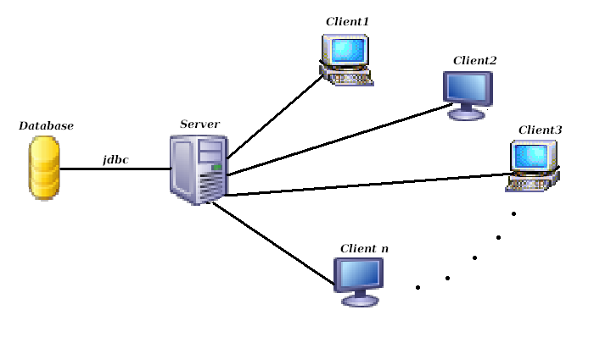
2. Overall Description
2.1 Product Perspective:
. A simple diagram that shows the major components of the overall system, subsystem interconnections is shown below.

Slide 9
2.2 Product Functions:
At the client side
The main function of BM is to track the users, who share their resources over the internet, interact with each other.
Get the no. of packets they downloaded /uploaded send it to the server.
At the server side
Log the details.
Generate the reports.

Slide 10
2.3 User Characteristics:
The major user classes that are expected to use this software are as follows
Software Administrator
The Software Administrator are the main users of this software. They are expected to keep track of the no. of packets downloaded and uploaded periodically and maintain the traffic report provided by this software.
General Users
The general users are expected to generally perform downloading and uploading of files, specially videos, audios and documents for which our software provides the bandwidth monitoring and traffic reports

Slide 11
2.4 General Characteristics:
This software is a web based application. A major constraint on the performance will be due to the client’s usage.
2.5 Assumptions and Dependencies:
System has client-server architecture.
Clients send the upload, download statistics to the server.
Server maintains the statistics and gives graphical, numerical representations.
Server generates the reports.
The software is Main Server dependant, and so if due to some reason the Main Server crashes, the whole software will crash.

Slide 12
3. Specific Requirements:
3.1 External Interface Requirements
3.1.1 User Interface:
Basically there will be 3 user interfaces provided by the software
1.Bandwidth Usage Notification
2.Traffic Summary
3.Graphical view
3.1.2 Hardware Interface
PROCESSOR : PENTIUM IV 2.6 GHz
RAM : 512 MB DD RAM
MONITOR : 15” COLOR
HARD DISK : 120 GB

Slide 13
3.1.3 Software Interface:
Software will depend on the security features provided by the operating system and the language java
Software Requirements :
JDK 1.5
Java Swings ,servlets,networking.
JDBC.
3.1.4 Communication Interface:
Features will be provided for user (of software) for monitoring the bandwidth. The basic communication protocols will be UDP and TCP for file transfer

Slide 14
3.1.5 SYSTEM FEATURES:
Description and Priority:
Running as a system service that monitors bandwidth usages and generate traffic reports automatically.
Real-time graphical and numerical bandwidth speed displaying.
Provides daily, weekly, monthly and summary bandwidth usage reports.

Slide 15
Functional Requirements:
Main Functionality of Software:
Displays real time upload and download speeds in graphical and numerical form.
Logs bandwidth usage.
Providing daily,weekly and monthly bandwidth usage report.
Bandwidth usage notification.

Slide 16
Use cases specify the Functionality of a system by specifying the behaviour of the system.
Use case 1:Monitoring the bandwidth and showing graphs for uploaded and downloaded results.
Primary Actor: Server
Precondition: Client has logged in and uploaded the data or downloaded.
Main Success Scenario:
Server receives the packets from clients after uploading or downloading data by Client machine.
Records or develops the graph for the particular uploads and downloads.
Server after completing its task switches to other.
Exception Scenario:
-Client has not uploaded or downloaded any data.

Slide 17
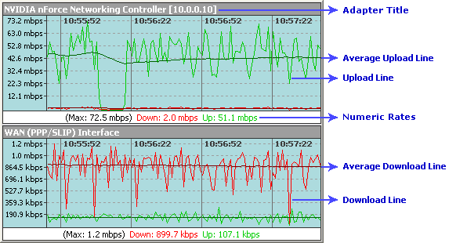

Slide 18
Use case 2: Recording or logging the uploaded and downloaded results .
Primary Actor: Server.
Precondition: Server is active and can receive the packets from client machine after suitable uploads or downloads.
Main Success Scenario:
Server with this Software maintains a database of all the clients information based on the packets sent or received in kbps.
Based on the bandwidth usage the server keeps track of upload and download speed utilization etc separately.
Server frequently updates the database.
Exception Scenario:
-Connection may be lost.
-Acknowledgement may not happen.

Slide 19
Use case 3:Daily report of bandwidth usage.
Primary Actor: Server.
Precondition: Server remains active from the duration specified.
Main Success Scenario:
Server monitors the bandwidth rates of uploads and downloads every day and every moment.
Generates the suitable day to day reports and stores in database the day and the bandwidth usage on that day and name of client machine.
Exception Scenario:
-In the course of monitoring the monthly bandwidth usage server may crash.
-In the course of monitoring ,database may crash.

Slide 20
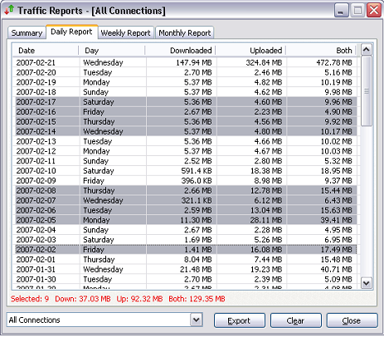

Slide 21
Use case 4:Weekly report of bandwidth usage.
Primary Actor: Server.
Precondition: Server remains active from the duration specified.
Main Success Scenario:
Server monitors the bandwidth rates of uploads and downloads every day and every moment.
Generates the suitable weekly reports and stores in database the starting and end day of week and the bandwidth usage for that month and name of client machine.
Exception Scenario:
-In the course of monitoring the monthly bandwidth usage server may crash.
-In the course of monitoring ,database may crash.

Slide 22
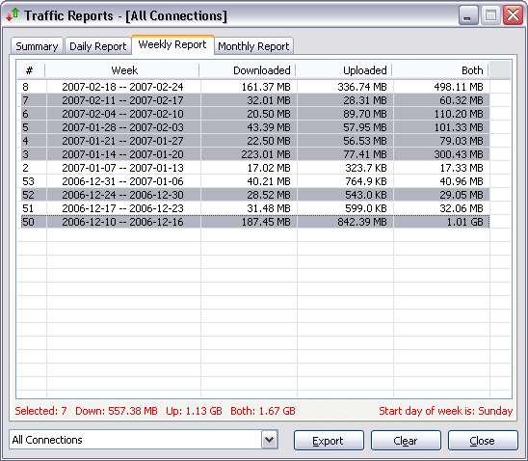

Slide 23
Use case 5:Monthly report of bandwidth usage.
Primary Actor: Server.
Precondition: Server remains active from the duration specified.
Main Success Scenario:
Server monitors the bandwidth rates of uploads and downloads every day and every moment.
Generates the suitable reports for the entire month for effective bandwidth utilization and stores in database the name of month and the effective bandwidth usage for that month and name of client machine.
Exception Scenario:
-In the course of monitoring the monthly bandwidth usage server may crash.
-In the course of monitoring ,database may crash.

Slide 24
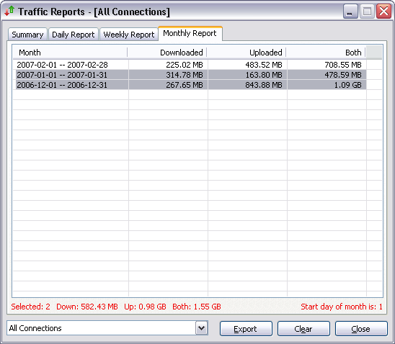

Slide 25
Use case 6:Notification after the exceeded bandwidth usage.
Primary Actor: Server.
Precondition: Server is logged in and keeps track of all the bandwidth usages.
Main Success Scenario:
Server monitors the bandwidth usage of all its client machines.
After the Specified level of usage, server notifies to the client machine about excess usage of bandwidth after upload or downloads.
Notification is in the form of beep sound.

Slide 26
DETAILED
DESIGN

Slide 27
LIST OF MAIN CLASSES
S.No | Class Name
1 | PacketMonitor
2 | BandwidthMoniotr
3 | TrafficReporter
27
27

Slide 28
AT CLIENT SIDE:
CLASSES:
PacketMonitor
SocketClient
28
28

Slide 29
CLASS PacketMonitor
//Input: Usage of available interfaces for
communication.
//Output: Captures the Packets during upload
/Download.
Step1:Imports Jpcap package.
JPcap: is a Java class package which enables to
capture and send IP packets from Java
application. This package uses libpcap and Raw
Socket API.

Slide 30
Using statements:
import jpcap.packet.*;
import jpcap.JpcapCaptor;
import jpcap.JpcapSender;
import jpcap.NetworkInterface;
import jpcap.NetworkInterfaceAddress;

Slide 31
Step2: Fetch available interfaces to listen on
Using inbuilt function getDevicelist().
Socket. These interfaces may be NIC, Ethernet card etc.
Step3:Based on Particular interface selected a device listener is setup.
Listens only to TCP/IP packets using setFilter() function.
Step 4:
start listening for packets
while (true) {
Packet info = getPacket();
If packet content not null
getPacketText(info) function called to retrieve the text in
packet.
Listens separately for uploaded and downloaded data.
}

Slide 32
Step 5:getPacketText()
{//Input: Captured Packet
//Output: Length of Data in Packet.
return packet data in true text
Packet is taken and analysed.
byte[] bytes=new byte[pack.header.length + pack.data.length];
Extract the Header length of packet and copy it to variable Pack_header.
Extract the data length of packet using packet format and copy
it to an variable Pack_data.
StringBuffer buffer = new StringBuffer();
Create a String buffer for Storing the bytes of data.
Convert bytes in hexadecimal to binary.
}

Slide 33
Step 6: Rate()
{
//Input: Length of Data in each packet
//Output: Uploaded or downloaded rate.
int download, upload;//initialised to 0
download<- download+Pack_data
Upload<-upload+pack_data
}

Slide 34
Sequence diagram for Packet Monitor:
NETWORK
Packet Monitor
Packet
Monitor
Packet Monitor
Analyse
packet()
Get packet
len()
Store packetsize()
Capture packets.
Analyse captured packet
Based on packet format
Increement
Var until end of packets

Slide 35
PacketMonitor DFD :
Store len by increementing in a variable
Inc packet
len.
Store &
Send traffic rate
Send to server
Inc packet
len.
Get
Packet
length()
Using pkt format
Capture
Packets()
Analyse
Packet()
Network
Download/upload
Send packets

Slide 36
Algorithm for BandwidthMonitor:
public class bandwidthMonitor {
//method to receive the traffic rates from the clients
public void receiveTrafficRate(string IP,int upload,int download)
{
Step1: try{
server <-new ServerSocket(port no);
} catch (IOException e){
print the suitable statement for the exception
}
Step2:try{
client <-server.accept();
} catch (IOException e) {
print the suitable statement for the exception
}

Slide 37
Step3: try{
in <-new BufferedReader(new InputStreamReader(client.getInputStream()));
out <- new PrintWriter(client.getOutputStream());
} catch (IOException e) {
print the suitable statement for the exception
}
//if true enter the loop (i.e while loop)
Step4: try{
line <- in.readLine();
//Send data back to client
out.println(line);
} catch (IOException e) {
print the suitable statement for the exception }
}

Slide 38
//store the traffic rates sent from the client in database
public void storeTrafficRate(string IP,int upload,int download)
{ //database MYSQL Server
//Input: ip address, upload & download rates
Connection con <-null;
String url <-"jdbc:mysql://localhost:3306/";
String dbName <-"jdbctutorial";
String driverName <- "com.mysql.jdbc.Driver";
String userName <-"root";
String password <- "root";
Step1:try{
Class.forName(driverName).newInstance();
con <-DriverManager.getConnection(url+dbName, userName, password);
Step2:try{
Statement st <-con.createStatement();

Slide 39
String table <- "CREATE TABLE CRate (IP varchar(15),upload integer, download integer)";
st.executeUpdate(table);
String table <- "CREATE TABLE DRate (IP varchar(15),upload integer, download integer)";
st.executeUpdate(table);
}catch(SQLException s){
print suitable message for the exception
}//exception caught of inner try block
con.close();
} catch (Exception e){
print suitable message for the exception
}//exception caught of outer try block
}
}

Slide 40
Sequence diagram for Bandwidth Monitor:
packet
Monitor
bandwidth Monitor
bandwidth Monitor
bandwidth Monitor
sendTrafficRate();
recieveTrafficRate();
storeTrafficRate();
generate Graph();
receive Traffic Rate
store traffic rate
Along with IP address
Generate graph for the traffic rate received
in n sec dynamically

Slide 41
Bandwidth Monitor DFD :
trafficRate(stored in database)
recieveTraffic
Rate();
storeTrafficRate();
packet Monitor
Sends traffic rate
store traffic rate
Along with IP address
nsec traffic rate values
generateGraph();

Slide 42
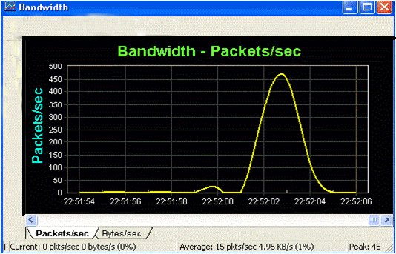
Bandwidth Monitor Graph:

Slide 43
ER Diagram.
IP_Address
IP_Address
Date
CURRENT_TRAFFIC
N
1
GIVES
DAILY_TRAFFIC
Upload
Upload
Download
Download

Slide 44
TraficReporter
DATA MEMBERS
date1
date2
METHODS
getDailyReport()‏
getReportBetween2Dates()‏
44
44

Slide 45
DFD :
Establish Connection to backend
Connection
object
Load JDBC Driver
Statement object
Date(s)‏
query
result
Store the query result
Query the database
get date(s)‏
Date(s)‏
User

Slide 46
Sequence Diagram :
MAIN_ MENU
MENU
TrafficReporter
TrafficReporter
DisplayReport
mainMenu()‏
menu()‏
getReport()‏
getReport()‏
init()‏
get Choice
get Date
Query the
database
establish connection to backend
Result
Display
46

Slide 47
Algorithm for trafficReporter:
//Requires java.sql package
getDailyReport()‏
//input : Date.
//output : ResultSet object.
begin
try
begin
load JDBC driver. //using forName() method
establish connection to the backend database.//using getConnection() method.
create Statement object.
pass the query as parameter to executeUpdate().
store the query result in ResultSet class object.
end(try)‏

Slide 48
Algorithm Continued ...
catch(Exception e)‏
begin
print stack trace using printStackTrace() method.
end(catch)‏
end (getDailyReport)‏

Slide 49
TraficReporter
//Requires java.sql package
getReportBetween2Dates()‏
//input : From date, to Date.
//output : ResultSet object.
begin
try
begin
load JDBC driver. //using forName() method
establish connection to the backend database.//using getConnection() method.
create Statement object.
pass the query as parameter to executeUpdate().
store the query result in ResultSet class object.
end(try)‏
49

Slide 50
Algorithm Continued ...
catch(Exception e)‏
begin
print stack trace using printStackTrace() method.
end(catch)‏
end
50

Slide 51
DisplayDailyReport
DATA MEMBERS
No data members.
METHODS
init()‏
51
51

Slide 52
DisplayDailyReport
//Requires javax.swing and java.awt packages
//class containg this method need to extend from JApplet class
init()‏
//input :ResultSet object.
//output :displays Traffic of given date in tabular form.
does not return any thing.
begin
get content pane and store it in Container class object.//use getContentPane() method.
set layout manager //using setLayout(BorderLayout) method.
52

Slide 53
Algorithm Continued ...
initialize column heading in 1D String array.
initialize data in 2D Object array.
create JTable object to create table & pass data, heading created above as parameters.
create JScrollPane object to include scroll bars.
add it to content pane using add(JScrollPane) method.
end(init).
53

Slide 54
DFD:
get content pane
Container
object
set layout manager
Container
object
Create JTable object
add JTable to
content pane
output
Data
output
TrafficReporter class
user

Slide 55
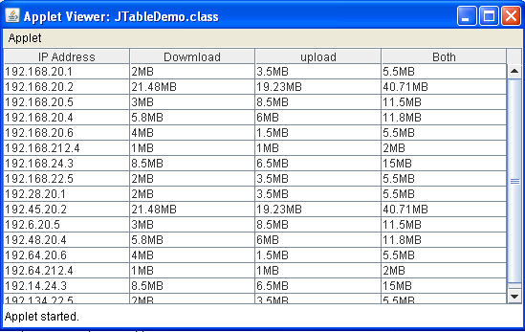

Slide 56
DisplayReportBetween2Days
DATA MEMBERS
No data members.
METHODS
init()‏
56
56

Slide 57
DisplayReportBetween2Days
//Requires javax.swing and java.awt packages
//class containg this method need to extend from JApplet class
init()‏
//input :ResultSet object.
//output :displays Traffic of given 2 dates in tabular form.
does not return any thing.
begin
get content pane and store it in Container class object.//use getContentPane() method.
set layout manager //using setLayout(BorderLayout) method.
57

Slide 58
Algorithm Continued ...
initialize column headings in 1D String array.
initialize data in 2D Object array.
create JTable object to create table & pass data, heading created above as parameters.
create JScrollPane object to include scroll bars.
add it to content pane using add(JScrollPane) method.
end(init).
58

Slide 60
Thank You

